Slide 1
Cryptography Practical Project
Maxfield England and Tyler Lorella

Slide 2
Symmetric Encryption Demo!

Slide 3

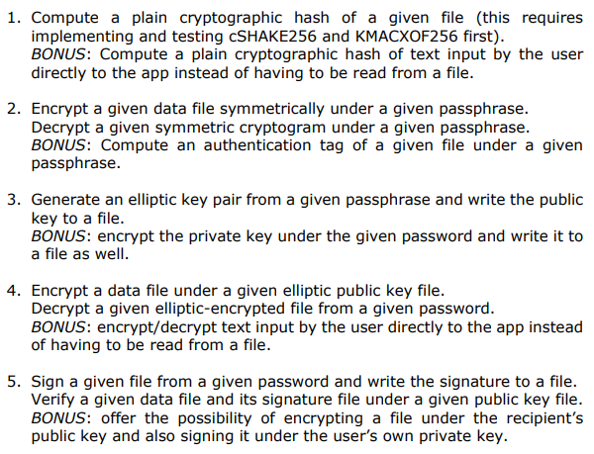
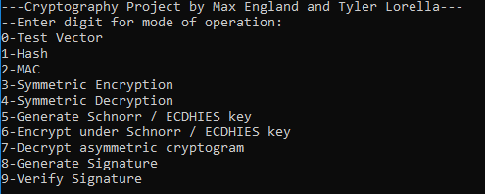
Other modes of operation

Slide 4

Issues encountered with the project
Translating C code
Reading specification documentation
Matching C-Shake test vector
C-Shake Test Vector: 11000001 11000011 01101001 00100101 10110110 01000000 10011010 00000100...

Slide 5
Have a good rest of the semester!
Questions?

